Slide 1

Chapter 7
Transmission Media
7.<number>
Copyright © The McGraw-Hill Companies, Inc. Permission required for reproduction or display.

Slide 2

Figure 7.1 Transmission medium and physical layer
7.<number>

Slide 3
Overview
Characteristics and quality determined by medium and signal
For guided, the medium is more important
For unguided, the bandwidth produced by the antenna is more important
Key concerns are data rate and distance

Slide 4

Figure 7.2 Classes of transmission media
7.<number>

Slide 5
Design Factors
Bandwidth
  Higher bandwidth gives higher data rate
Transmission impairments
  Attenuation
Interference
Number of receivers
  In guided media

Slide 6
Guided Transmission Media
Guided media, which are those that provide a conduit from one device to another, included
Twisted Pair
Coaxial cable
Optical fiber

Slide 7
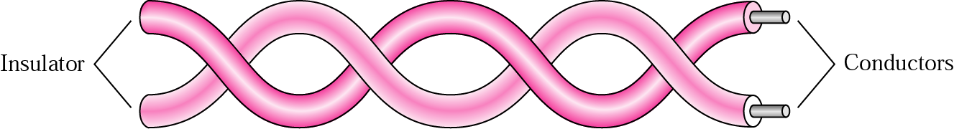
Twisted Pair
A twisted pair consists of two conductors (normally Copper), each with its own plastic insulation, twisted together. One wire is used to carry signal while other one is used as a reference.

Slide 8
Unshielded and Shielded TP
Unshielded Twisted Pair (UTP)
  Ordinary telephone wire
  Cheapest
  Easiest to install
  Suffers from external Electro-magnetic interference
Shielded Twisted Pair (STP)
  Metal braid or sheathing that reduces interference
  More expensive
  Harder to handle (thick, heavy)

Slide 9
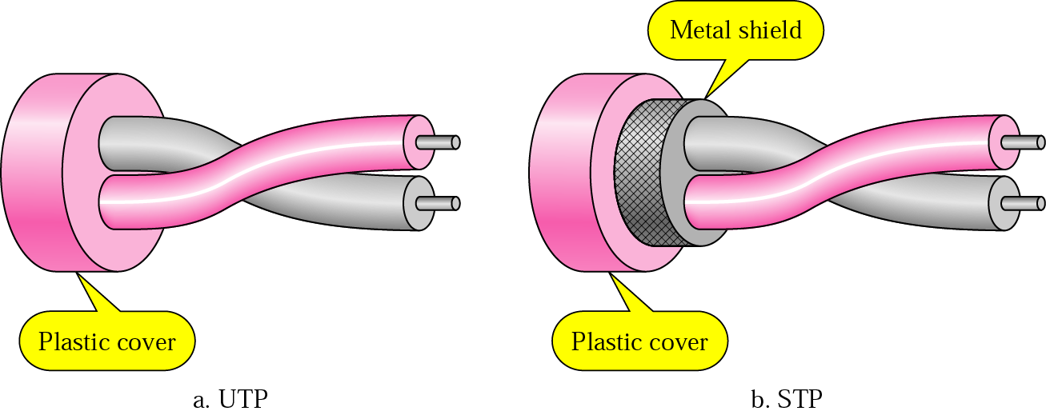
UTP and STP

Slide 10
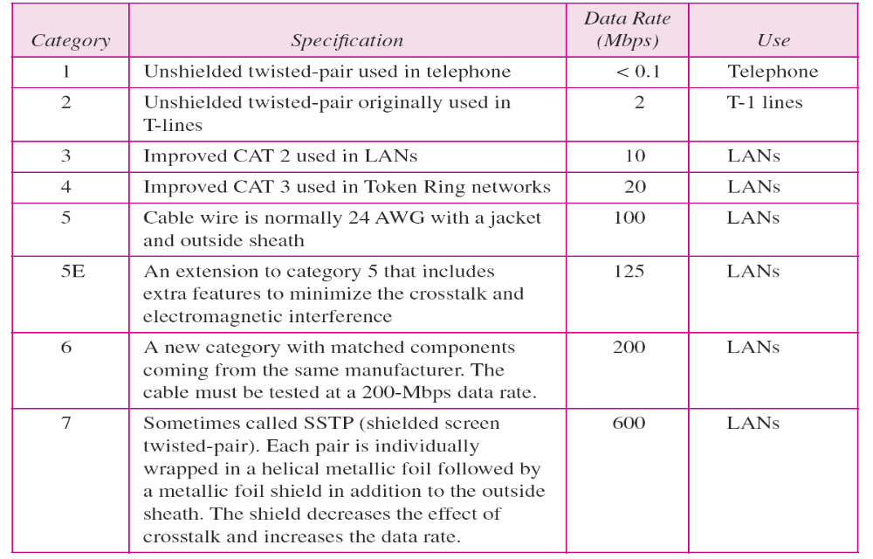
Categories of unshielded twisted-pair cables

Slide 11
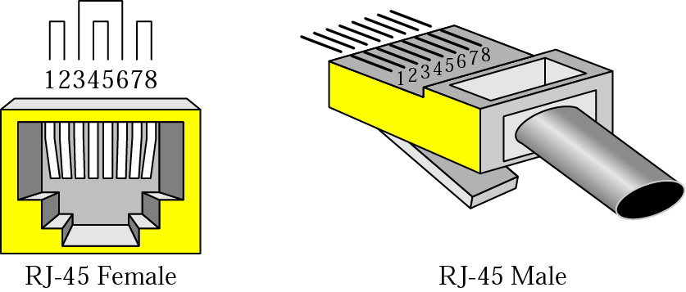
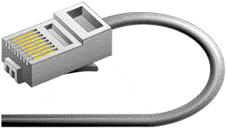
RJ-45 Connector

Slide 12
Twisted Pair - Applications
Most common medium
Telephone network
  Between house and local exchange (subscriber loop)
Within buildings
For local area networks (LAN)
  10Mbps or 100Mbps

Slide 13
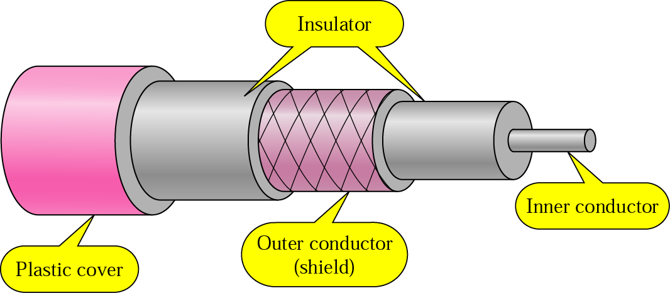
Coaxial Cable

Slide 14
Coaxial Cable
A single wire wrapped in a foam insulation surrounded by a braided metal shield, then covered in a plastic jacket. Cable can be thick or thin.
Base band coaxial technology uses digital signaling in which the cable carries only one channel of digital data.
Broadband coaxial technology transmits analog signals and is capable of supporting multiple channels of data.

Slide 15
Categories of coaxial cables
Category | Impedance | Use
RG-59 | 75 Ω | Cable TV
RG-58 | 50 Ω | Thin Ethernet
RG-11 | 50 Ω | Thick Ethernet

Slide 16
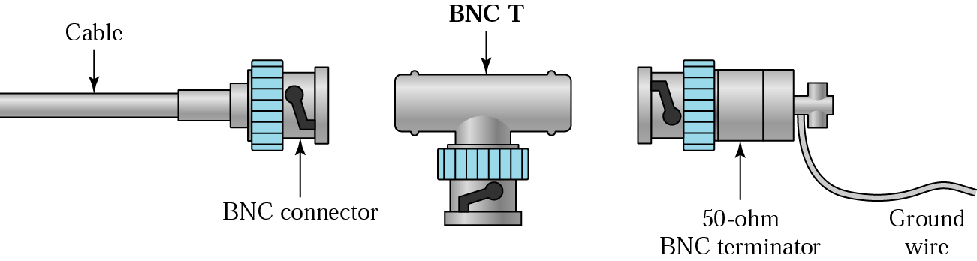
BNC Connectors

Slide 17
Coaxial Cable Applications
Most versatile medium
Television distribution
  Cable TV
Long distance telephone transmission
  Can carry 10,000 voice calls simultaneously
  Being replaced by fiber optic
Short distance computer systems links
Local area networks
Maximum cable length 500m in case of Thick Ethernet and 185 m in Thin Ethernet.

Slide 18

Figure 7.10 Bending of light ray
7.<number>

Slide 19

Figure 7.11 Optical fiber
7.<number>

Slide 20

Fiber Optics Propagation Modes
Optical fibers come in two types:
  Single-mode fibers
  Multi-mode fibers

Slide 21
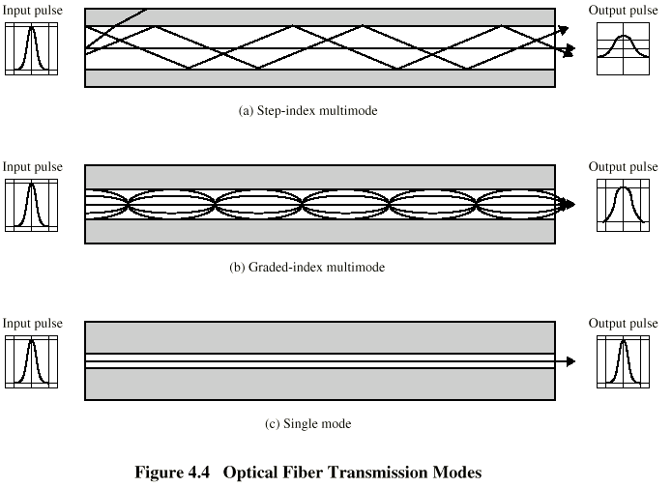
Optical Fiber Transmission Modes

Slide 22
Single Mode Vs Multimode (1)
An optical fiber that supports only one propagation mode. (I.e. the light travels in only one ray)
Single-mode fibers have small cores (9 microns in diameter)
Laser is used as light source to transmit infrared laser light.
An optical fiber that supports more than one modes (I.e. the light travels in the core in many rays called modes)
Multi-mode fibers have larger cores (62.5 microns in diameter)
Light emitting diodes (LEDs) are used as light source.

Slide 23
Single Mode Vs Multimode (2)
Single-mode fiber gives you a higher transmission rate and up to 50 times more distance than multimode
Used by telephone and cable TV companies for long distance applications
More expensive than multimode
Multimode fiber gives you high bandwidth at high speeds over medium distances but less than single mode.
Used for slower local area networks (LANs)
Less Expensive than single mode

Slide 24
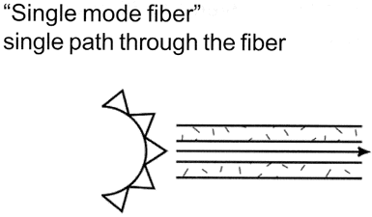
Single Mode figure

Slide 25
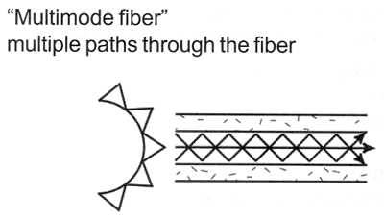
Multimode figure

Slide 26
Single mode and Multimode …
Micron: A micron is one one-millionth of a meter and 125 microns is 0.005 inches- a bit larger than the typical human hair.
In Single mode optical fiber due to the small core and single light-wave any distortion is virtually eliminated that could result from overlapping light pulses, providing the least signal attenuation and the highest transmission speeds of any fiber cable type.
Plastic Optical Fiber (POF) is large core (about 1mm) fiber that can only be used for short, low speed networks.

Slide 27
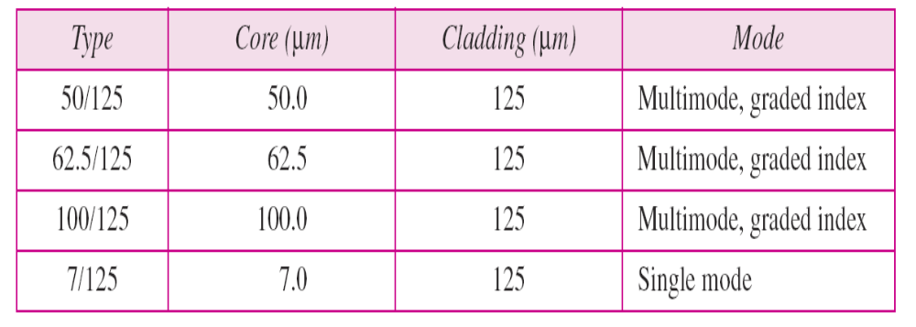
Fiber types

Slide 28
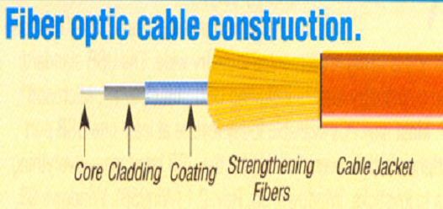
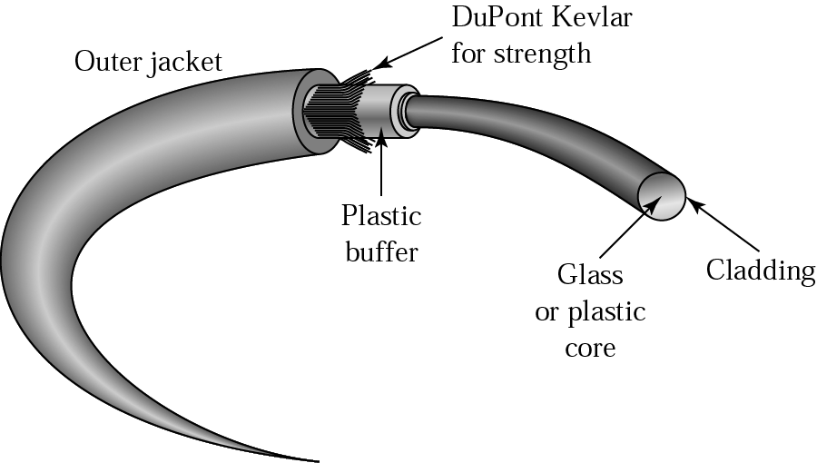
Optical Fiber construction

Slide 29
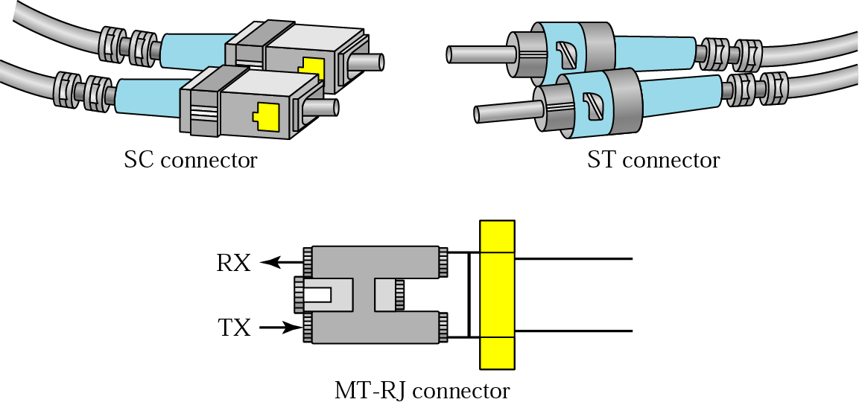
Fiber-optic cable connectors

Slide 30
Optical Fiber - Benefits
Greater capacity
  Data rates of hundreds of Gbps
Smaller size & weight
Lower attenuation
Electromagnetic isolation
Each fiber is a one way (simplex) channel for the light pulses
  i.e. two fibers needed for a two-way (duplex) connection

Slide 31
Optical Fiber - Applications
Long-haul trunks
Metropolitan trunks
Rural exchange trunks
Subscriber loops
LANs

Slide 32
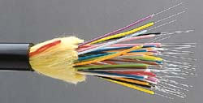
Fiber Optic Cable

Slide 33
Ethernet Cable Summary
Specification
Cable Type (Maximum length)
10BaseT
UTP (100 meters)
10Base2
Thin Coaxial (185 meters)
10Base5
Thick Coaxial (500 meters)
10BaseF
Fiber Optic (2000 meters)

Slide 34
Advantages and disadvantages of fiber optic cable
Advantages:
Higher bandwidth
Less signal attenuation
Immunity to electromagnetic interference
Resistance to corrosive materials
Light weight
Greater immunity to tapping
Disadvantages:
Installation and maintenance
Unidirectional light propagation
Cost
7.<number>

Slide 35
Lecture 10-11 Roadmap
Propagation Methods
  Ground Propagation
  Sky Propagation
  Line of Sight Propagation
Unguided (Wireless) transmission media
  Radio waves
  Microwave
    Terrestrial Microwave
    Satellite Microwave
  Infrared

Slide 36
Wireless Transmission
Unguided media transport electromagnetic waves without using a physical conductor. This type of communication is often referred to as wireless communication.
Unguided media
Transmission and reception via antenna

Slide 37
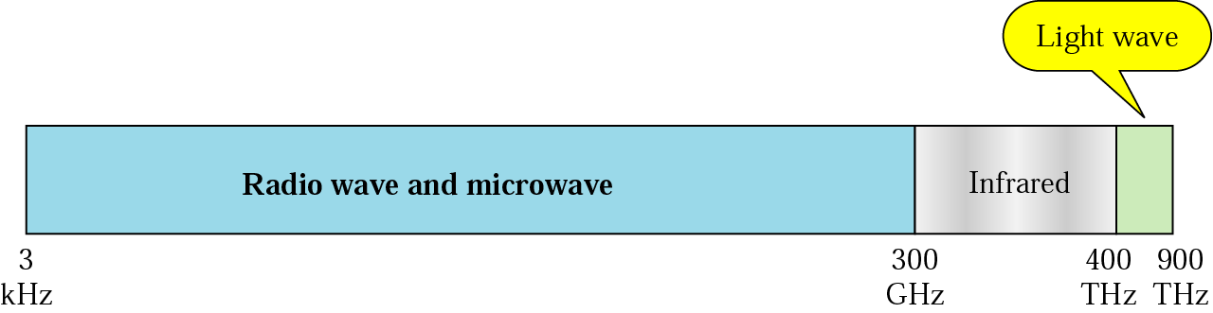
Electromagnetic spectrum for wireless communication
3KHz to 1GHz (Radio)
  Omni-directional
1GHz to 300GHz (Microwave Frequencies)
  Highly directional, Point to point, Satellite
300GHz to 400THz ⁽Infrared)
  Local
  Within confined area (single room)

Slide 38
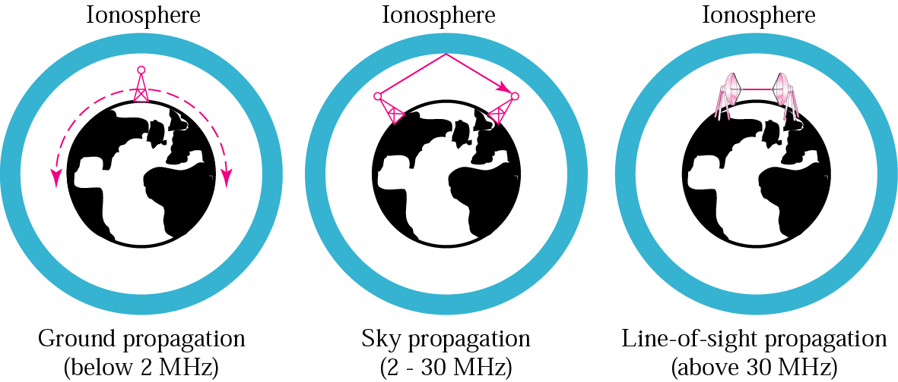
Propagation methods

Slide 39
Propagation methods
Ground propagation
In ground propagation, radio waves travel through the lowest portion of the atmosphere. These low frequency signals emanate in all directions from the transmitting antenna and follow the curvature of the planet.
Sky propagation
In sky propagation, higher frequency radio waves radiate upward in to the ionosphere where they are reflected back to the earth.
Line of sight propagation
Very high frequency signals are transmitted in straight lines directly from antenna to antenna. Antennas must be directional, facing each other

Slide 40

Bands

Slide 41

Wireless transmission waves

Slide 42
Radio Waves
Frequency Range generally used is 3 K Hz – 1GHz
Omni-directional
Does penetrate in walls
Same distance restrictions and attenuation rate as microwaves
FM radio
UHF and VHF television
Mobile Telephones
Suffers from multi-path interference
Reflections from buildings, airplanes, water, land, ionosphere etc

Slide 43

Omni directional antenna
Radio waves are used for multicast communications, such as radio and television, and paging systems.

Slide 44
Radio Waves
Advantages
  Not line of sight
  Can penetrate most solids and through walls
  Longer range
  Not light sensitive
Disadvantages
  Interference ( wireless phones, wrist radios can interfere)
  Lack of security (easier to "eavesdrop" on transmissions)
  Higher cost than infrared
  Federal Communications Commission(FCC) licenses required for some products
  Lower speed ( lower than wired and infrared transmission)

Slide 45
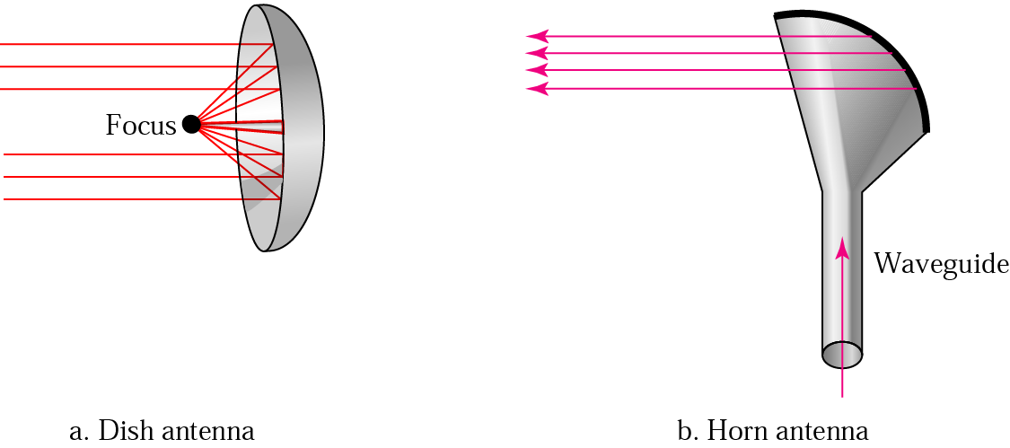
Microwaves
Microwaves are used for unicast communication such as cellular telephones, satellite networks, and wireless LANs.
Frequency range is between 1and 300 GHZ.

Slide 46
Micro Waves
Uni Directional
Frequency Range 1GHz-300GHz
No Interference
Used Line of Sight Propagation
Cannot penetrate walls
Band is Wide and regulated by authorities
7.<number>

Slide 47
Terrestrial Microwave
Terrestrial Microwave transmission systems transmit tightly focused beams of radio frequencies from one ground-based microwave antenna to another .
Antennas are usually located at substantial heights above the ground level.

Slide 48
Terrestrial Microwave
Parabolic dish (typically 3m in diameter)
Focused beam
Line of sight
Long haul telecommunications
Higher frequencies give higher data rates
Transmission Distance is limited by:
  Height of Antennas
  Intervening Obstacles in the path of signals

Slide 49
Terrestrial Microwave
With no intervening obstacles, the maximum distance between two antennas can be:
  D = 7.14 square root (Kh)
  Where, D = distance in km
  h = height of antenna
  K = adjustment factor (usually 4/3)

Slide 50
Terrestrial Microwave
Land-based, line-of-sight transmission
Approximately 20-30 miles maximum between towers
Transmits data at hundreds of millions of bits per second

Slide 51
Terrestrial Microwave Applications
Long haul telecommunication services
Short point-to-point links between buildings
Links between LANs
Links between different offices.

Slide 52
Terrestrial Microwave
Attenuation is the main transmission impairment
Higher microwave frequencies are used for short point-to-point links between buildings.
Higher frequencies are less useful for longer distances. WHY?

Slide 53
Terrestrial Microwave
Advantages
  High data rates
  Low cost land purchase for towers
  High freq /short wavelengths require small antennas
Disadvantages
  Attenuation by solid objects
  Reflected from flat surfaces, metal etc
  Line of sight is required

Slide 54
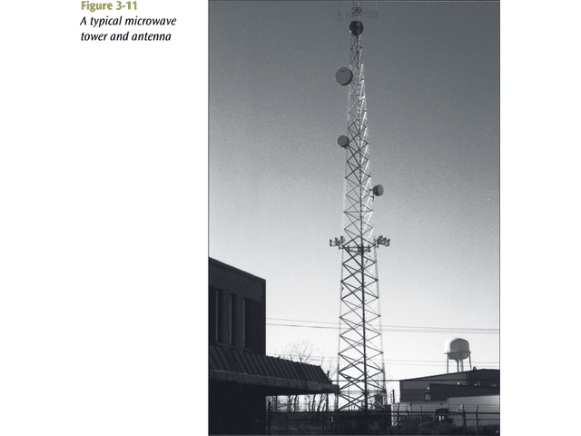
Microwave Tower

Slide 55
Satellite Microwave
In Satellite Microwave, the signals are transmitted from a ground station to a satellite and then after amplifying, from the satellite to some other ground station.
It covers large geographical areas than terrestrial microwaves

Slide 56
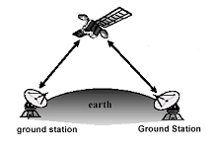
Satellite Microwave
Uplink
  Transmitting signals from
  a ground station to a satellite
Downlink
  Receiving signals from a satellite
  to a ground station
Transponders
  A satellite operates on a number
  of frequencies bands called
  transponder channels

Slide 57
Principal Satellite Transmission Bands
4 GHz (downlink) – 6 GHz (uplink) (first to be designed)
12 GHz (downlink) – 14 GHz (uplink)(rain interference is major problem)
19 GHz (downlink) – 29 GHz (uplink)(equipment to use this band is still very expensive)

Slide 58
Satellite Microwave
Satellite is relay station
Requires geo-stationary orbit
  To remain stationary, the satellite must have a period of rotation equal to earth’s rotation period.

Slide 59
Geostationary Satellite
For communication satellite to function effectively, it is generally required that it remains stationary with respect to its position over the earth. Otherwise, it would not be within the line-of-sight of its earth station at all the time. Satellite.

Slide 60
Satellite Microwave
LEO - Low Earth Orbit - 100 miles to 1000 miles. Used for wireless e-mail, special mobile telephones, videoconferencing.
MEO - Middle Earth Orbit - 1000 to 22,300 miles. Used by government and also provide Time and Location information.
GEO - Geosynchronous Orbit - 22,300 miles. Used for weather, television, and government operations.

Slide 61
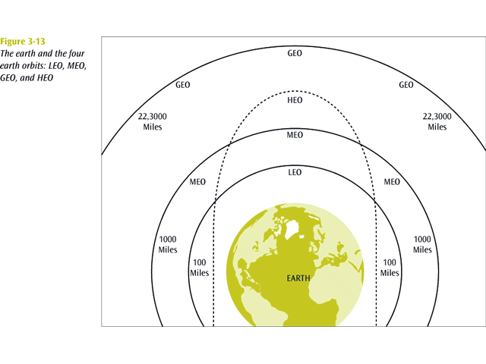
Earth Orbits

Slide 62
Applications of Satellite Microwave
Television
Long distance telephone
Private business networks

Slide 63
Infrared
Special transmissions that use a focused ray of light in the infrared frequency range
Line of sight (or reflection)
Blocked by walls
Typical data rates are up to 4 Mbps
Infrared radiation is the region of the electromagnetic spectrum between microwaves and visible light.
In infrared communication an LED transmits the infrared signal as bursts of non-visible light.
At the receiving end a photodiode or photoreceptor detects and captures the light pulses, which are then processed to retrieve the information they contain.

Slide 64
Infrared Applications
TVs, VCRs, CD players, stereos, In portable computers Car locking systems Headphones Home security systems Toys
Infrared signals can be used for short-range communication in a closed area using line-of-sight propagation.
Advantages
  Low power requirements (ideal for laptops, PDAs)
  Higher security (directionality ensure that data isn't leaked)
  High noise immunity
  No License is required
Disadvantages
  Line of sight, Short Range, Blocked by solid materials
  Light, weather sensitive

Slide 65
Factors to Select the Media
Cost
Data Rate and Bandwidth
Distance and expandability
Security
Environment

